Slide 1


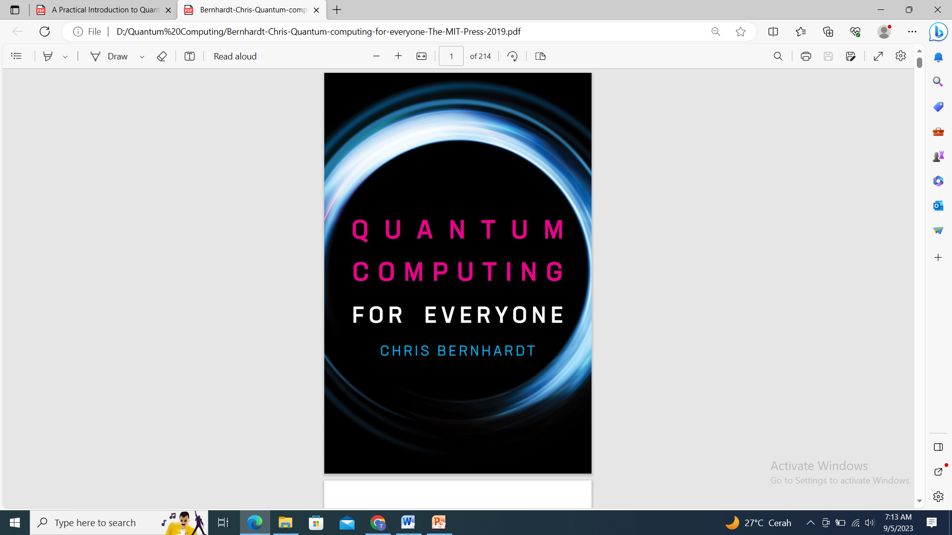

Quantum Gates and Circuits

Slide 2
MATERI
Cbit vs Qubit
Representasi dan Pengukuran Qubit Tunggal
Representasi dan Pengukuran Qubit Ganda
Operasi Pada Qubit Tunggal
Operasi Pada Qubit Ganda

Slide 3
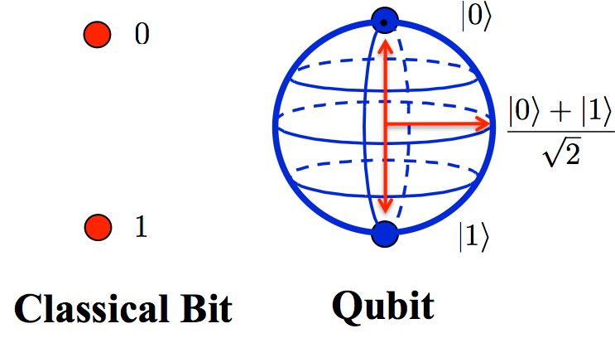
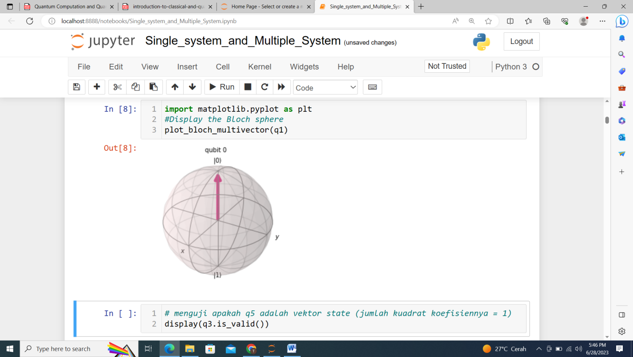
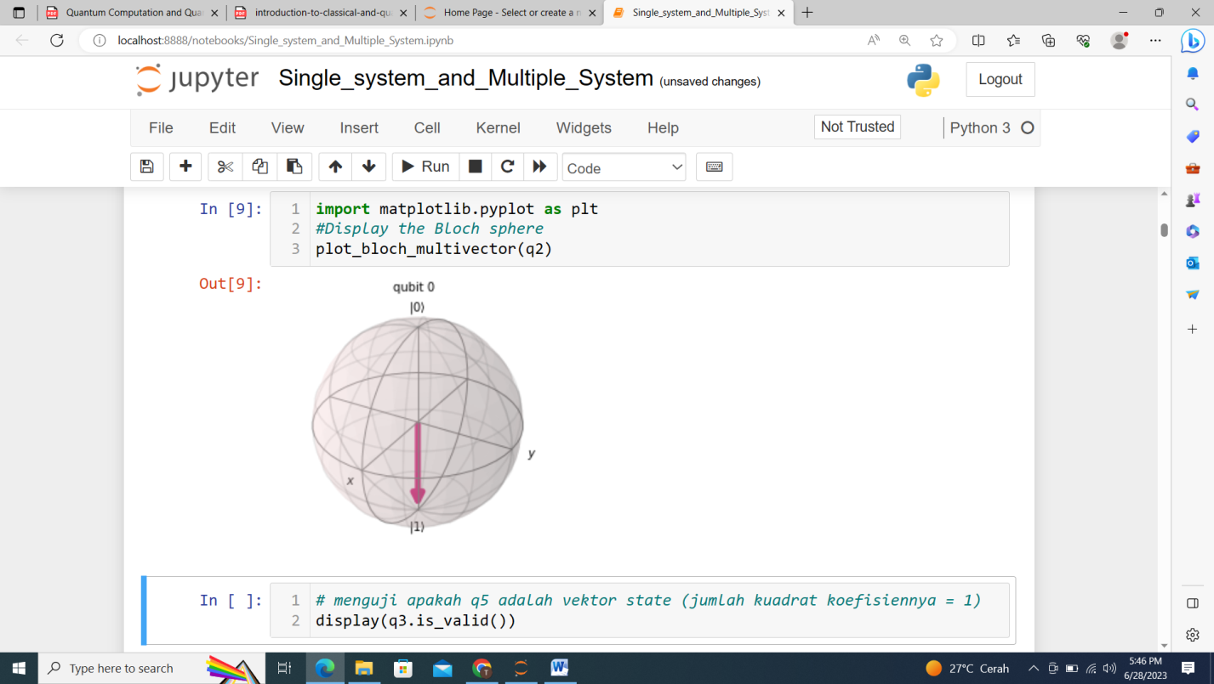

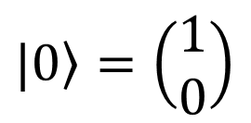
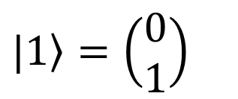
Cbit vs Qubit
Bloch Sphere
$\left.|0\right\rangle =\left(\begin{matrix}1 \\ 0\end{matrix}\right)$
$\left.|1\right\rangle =\left(\begin{matrix}0 \\ 1\end{matrix}\right)$

Slide 4
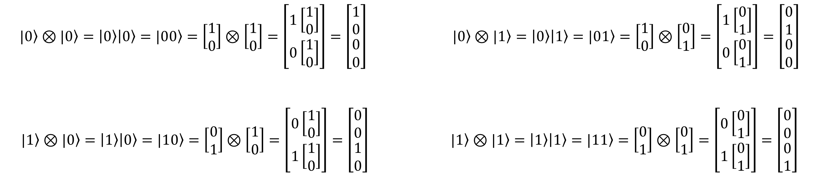
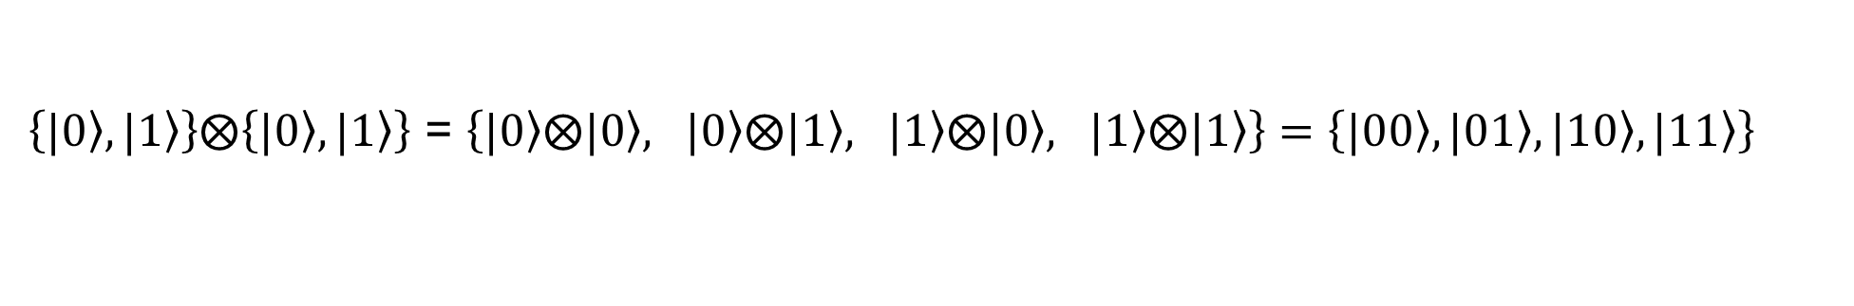
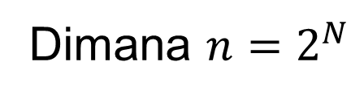
Basis States
Qubit Biner Desimal
1-Qubit $\left\{|\left.0\right\rangle ,|\left.1\right\rangle \right\}$ $\left\{|\left.0\right\rangle ,|\left.1\right\rangle \right\}$
2-Qubit $\left\{|\left.00\right\rangle ,|\left.01\right\rangle ,|\left.10\right\rangle ,|\left.11\right\rangle \right\}$ $\left\{|\left.0\right\rangle ,|\left.1\right\rangle ,|\left.2\right\rangle ,|\left.3\right\rangle \right\}$
3-Qubit $\left\{|\left.000\right\rangle ,|\left.001\right\rangle ,|\left.010\right\rangle ,|\left.011\right\rangle ,|\left.100\right\rangle ,|\left.101\right\rangle ,|\left.110\right\rangle ,|\left.111\right\rangle \right\}$ $\left\{|\left.0\right\rangle ,|\left.1\right\rangle ,|\left.2\right\rangle ,|\left.3\right\rangle ,|\left.4\right\rangle ,|\left.5\right\rangle ,|\left.6\right\rangle ,|\left.7\right\rangle \right\}$
N-Qubit $\left\{|\left.0\right\rangle ,|\left.1\right\rangle ,|\left.2\right\rangle ,……..……,|\left.n−1\right\rangle \right\}$
Catatan: 2-Qubit
Dimana $n=2^{N}$
$\left\{|\left.0\right\rangle ,|\left.1\right\rangle \right\}⨂\left\{|\left.0\right\rangle ,|\left.1\right\rangle \right\}$ = $\left\{|\left.0\right\rangle ⨂|\left.0\right\rangle , |\left.0\right\rangle ⨂|\left.1\right\rangle , |\left.1\right\rangle ⨂|\left.0\right\rangle , |\left.1\right\rangle ⨂|\left.1\right\rangle \right\}=\left\{|\left.00\right\rangle ,|\left.01\right\rangle ,|\left.10\right\rangle ,|\left.11\right\rangle \right\}$
$$|\left.0\right\rangle ⊗|\left.0\right\rangle =\left|\left.0\right\rangle \right|\left.0\right\rangle =|\left.00\right\rangle =\left[\begin{matrix}1 \\ 0\end{matrix}\right]⊗\left[\begin{matrix}1 \\ 0\end{matrix}\right]=\left[\begin{matrix}1\left[\begin{matrix}1 \\ 0\end{matrix}\right] \\ 0\left[\begin{matrix}1 \\ 0\end{matrix}\right]\end{matrix}\right]=\left[\begin{matrix}1 \\ 0 \\ \begin{matrix}0 \\ 0\end{matrix}\end{matrix}\right] |\left.0\right\rangle ⊗|\left.1\right\rangle =\left|\left.0\right\rangle \right|\left.1\right\rangle =|\left.01\right\rangle =\left[\begin{matrix}1 \\ 0\end{matrix}\right]⊗\left[\begin{matrix}0 \\ 1\end{matrix}\right]=\left[\begin{matrix}1\left[\begin{matrix}0 \\ 1\end{matrix}\right] \\ 0\left[\begin{matrix}0 \\ 1\end{matrix}\right]\end{matrix}\right]=\left[\begin{matrix}0 \\ 1 \\ \begin{matrix}0 \\ 0\end{matrix}\end{matrix}\right]$$
$$|\left.1\right\rangle ⊗|\left.0\right\rangle =\left|\left.1\right\rangle \right|\left.0\right\rangle =|\left.10\right\rangle =\left[\begin{matrix}0 \\ 1\end{matrix}\right]⊗\left[\begin{matrix}1 \\ 0\end{matrix}\right]=\left[\begin{matrix}0\left[\begin{matrix}1 \\ 0\end{matrix}\right] \\ 1\left[\begin{matrix}1 \\ 0\end{matrix}\right]\end{matrix}\right]=\left[\begin{matrix}0 \\ 0 \\ \begin{matrix}1 \\ 0\end{matrix}\end{matrix}\right] |\left.1\right\rangle ⊗|\left.1\right\rangle =\left|\left.1\right\rangle \right|\left.1\right\rangle =|\left.11\right\rangle =\left[\begin{matrix}0 \\ 1\end{matrix}\right]⊗\left[\begin{matrix}0 \\ 1\end{matrix}\right]=\left[\begin{matrix}0\left[\begin{matrix}0 \\ 1\end{matrix}\right] \\ 1\left[\begin{matrix}0 \\ 1\end{matrix}\right]\end{matrix}\right]=\left[\begin{matrix}0 \\ 0 \\ \begin{matrix}0 \\ 1\end{matrix}\end{matrix}\right]$$

Slide 5
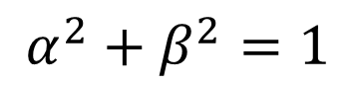
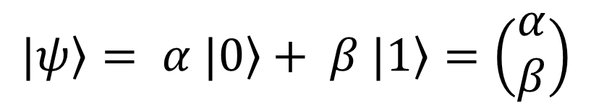
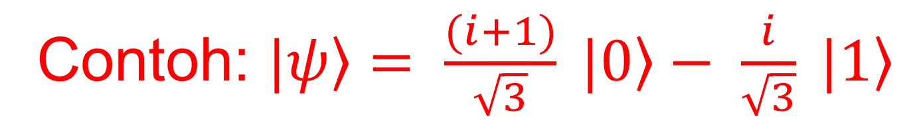
Representasi Qubit Tunggal
$$\left.|ψ\right\rangle = α \left.|0\right\rangle + β \left.|1\right\rangle =\left(\begin{matrix}α \\ β\end{matrix}\right)$$
Syarat :
$$α^{2}+β^{2}=1$$
dimana $α,β$adalah bilangan kompleks berbentuk $z=x+iy$, dengan $i=\sqrt{−1}$
Probabilitas untuk mendapatkan state $\left.|0\right\rangle$ = $α^{2}$
Probabilitas untuk mendapatkan state $\left.|1\right\rangle$ = $β^{2}$
Contoh: $\left.|ψ\right\rangle = \frac{(i+1)}{\sqrt{3}} \left.|0\right\rangle − \frac{i}{\sqrt{3}} \left.|1\right\rangle$

Slide 6
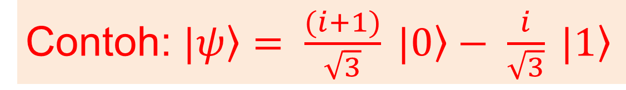
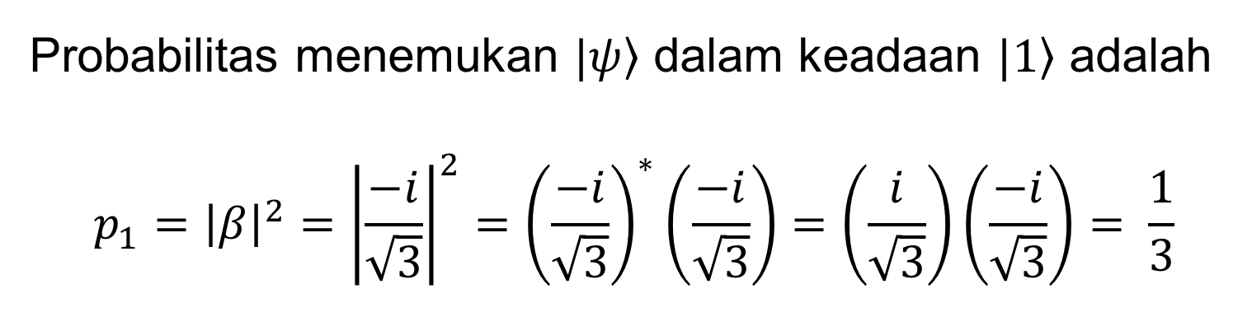
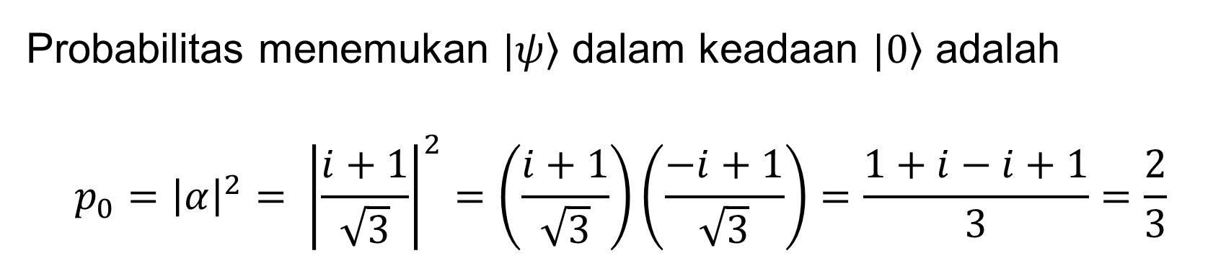
Pengukuran Qubit Tunggal
Ketika state Qubit |ψ⟩ diukur,
Probabilitas untuk mendapatkan state $\left.|0\right\rangle$ = $α^{2}$
Contoh: $\left.|ψ\right\rangle = \frac{(i+1)}{\sqrt{3}} \left.|0\right\rangle − \frac{i}{\sqrt{3}} \left.|1\right\rangle$
Probabilitas untuk mendapatkan state $\left.|1\right\rangle$ = $β^{2}$
Probabilitas menemukan $\left.|ψ\right\rangle$ dalam keadaan $\left.|0\right\rangle$ adalah
$$p_{0}={\left|α\right|}^{2}= {\left|\frac{i+1}{\sqrt{3}}\right|}^{2}=\left(\frac{i+1}{\sqrt{3}}\right)\left(\frac{−i+1}{\sqrt{3}}\right)=\frac{1+i−i+1}{3}=\frac{2}{3}$$
Probabilitas menemukan $\left.|ψ\right\rangle$ dalam keadaan $\left.|1\right\rangle$ adalah
$$p_{1}={{\left|β\right|}^{2}=\left|\frac{−i}{\sqrt{3}}\right|}^{2}={\left(\frac{−i}{\sqrt{3}}\right)}^{∗}\left(\frac{−i}{\sqrt{3}}\right)=\left(\frac{i}{\sqrt{3}}\right)\left(\frac{−i}{\sqrt{3}}\right)= \frac{1}{3}$$
verifikasi jumlah probabilitas : $p_{0}+p_{1}={\left|α\right|}^{2}+ {\left|β\right|}^{2}= \frac{2}{3}+ \frac{1}{3}=1$

Slide 7
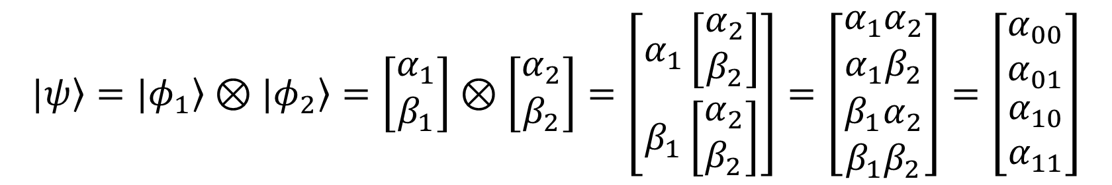
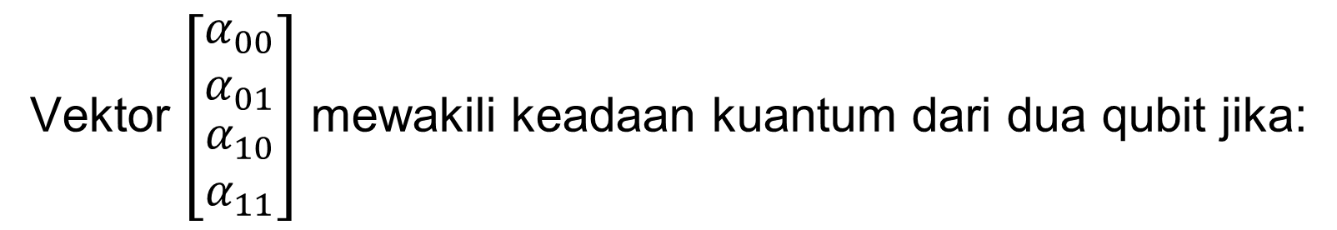
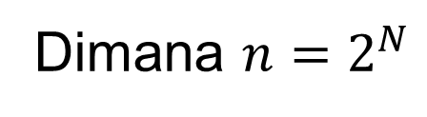
Representasi Qubit Ganda
Jika diberikan dua qubit terpisah, $|\left.φ_{1}\right\rangle =\left[\begin{matrix}α_{1} \\ β_{1}\end{matrix}\right]$ dan $|\left.φ_{2}\right\rangle =\left[\begin{matrix}α_{2} \\ β_{2}\end{matrix}\right]$, keadaan dua qubit yang bersesuaian diberikan oleh $|\left.ψ\right\rangle$, yaitu produk tensor $|\left.φ_{1}\right\rangle ⊗|\left.φ_{2}\right\rangle$ yang didefinisikan sebagai berikut.
$$|\left.ψ\right\rangle =|\left.φ_{1}\right\rangle ⊗|\left.φ_{2}\right\rangle =\left[\begin{matrix}α_{1} \\ β_{1}\end{matrix}\right]⊗\left[\begin{matrix}α_{2} \\ β_{2}\end{matrix}\right]=\left[\begin{matrix}α_{1}\left[\begin{matrix}α_{2} \\ β_{2}\end{matrix}\right] \\ β_{1}\left[\begin{matrix}α_{2} \\ β_{2}\end{matrix}\right]\end{matrix}\right]=\left[\begin{matrix}α_{1}α_{2} \\ α_{1}β_{2} \\ \begin{matrix}β_{1}α_{2} \\ β_{1}β_{2}\end{matrix}\end{matrix}\right]=\left[\begin{matrix}α_{00} \\ α_{01} \\ \begin{matrix}α_{10} \\ α_{11}\end{matrix}\end{matrix}\right]$$
Vektor $\left[\begin{matrix}α_{00} \\ α_{01} \\ \begin{matrix}α_{10} \\ α_{11}\end{matrix}\end{matrix}\right]$ mewakili keadaan kuantum dari dua qubit jika:
$${\left|α_{00}\right|}^{2}+{\left|α_{01}\right|}^{2}+{\left|α_{10}\right|}^{2}+{\left|α_{11}\right|}^{2}=1$$
Secara umum, keadaan dua Qubit dapat ditulis sebagai :
${|\left.ψ\right\rangle =}^{ }α_{00}|\left.00\right\rangle +α_{01}|\left.01\right\rangle$+$α_{10}|\left.10\right\rangle$+$α_{11}|\left.11\right\rangle$ = $α_{0}|\left.0\right\rangle +α_{1}|\left.1\right\rangle$+$α_{2}|\left.2\right\rangle$+$α_{3}|\left.3\right\rangle$
Keadaan N-Qubit dapat ditulis sebagai :
${|\left.ψ\right\rangle =}^{ }α_{0}|\left.0\right\rangle +α_{1}|\left.1\right\rangle$+$α_{2}|\left.2\right\rangle$+$α_{3}|\left.3\right\rangle$ +…. + $α_{n−1}|\left.n−1\right\rangle$
Dimana $n=2^{N}$

Slide 8
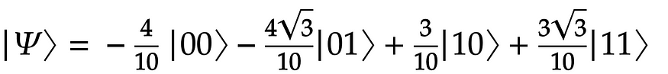
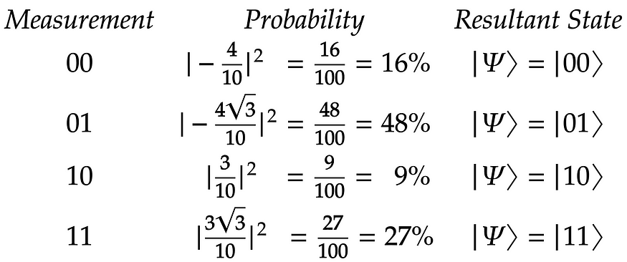
Pengukuran Qubit Ganda
Misalkan kita memiliki dua Qubit dengan status berikut :
Pengukuran Kuantum Qubit Penuh
Probabilitas dan status resultan untuk mengukur |00⟩ , |01⟩ , |10⟩ , dan |11⟩ masing-masing adalah 16%, 48%, 9%, dan 27%.

Slide 9
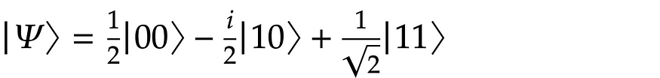
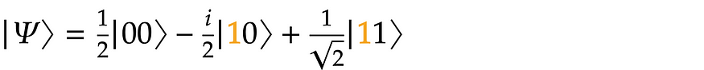
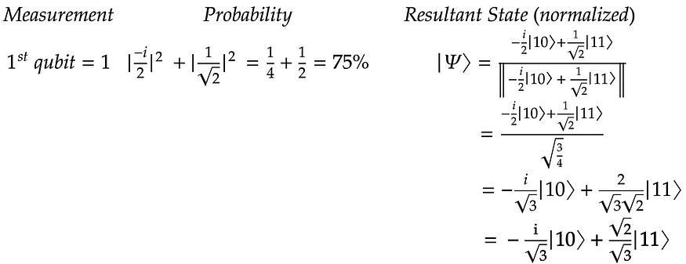
Pengukuran Qubit Ganda
Misalkan kita memiliki dua Qubit dengan status berikut :
Pengukuran Kuantum Qubit Parsial
Berikut ini adalah pengukuran qubit pertama untuk mendapatkan Qubit pertama = 1. Untuk melakukannya, kita hanya perlu memperhatikan status |10⟩ , dan |11⟩ yang memiliki qubit pertama = 1 (disorot di bawah).

Slide 10
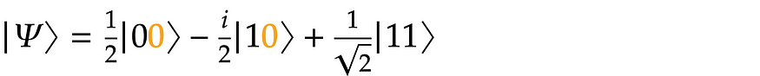
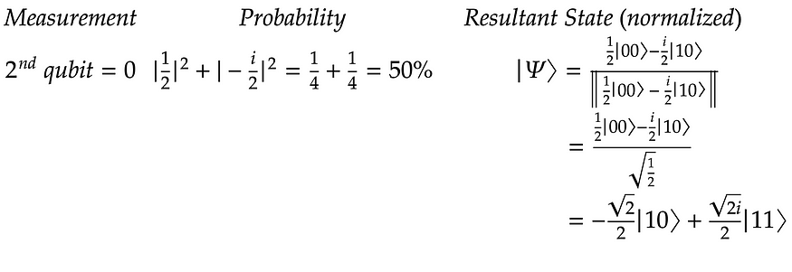
Pengukuran Qubit Ganda
Misalkan kita memiliki dua Qubit dengan status berikut :
Pengukuran Kuantum Qubit Parsial
Pengukuran untuk mendapatkan Qubit kedua = 0. Untuk melakukannya, kita hanya perlu memperhatikan status |00⟩ dan |10⟩ yang memiliki Qubit kedua = 0 (disorot di bawah).

Slide 11
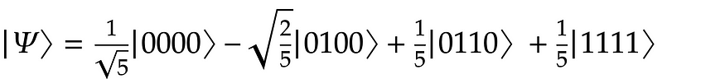
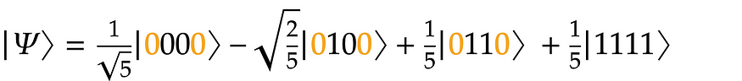
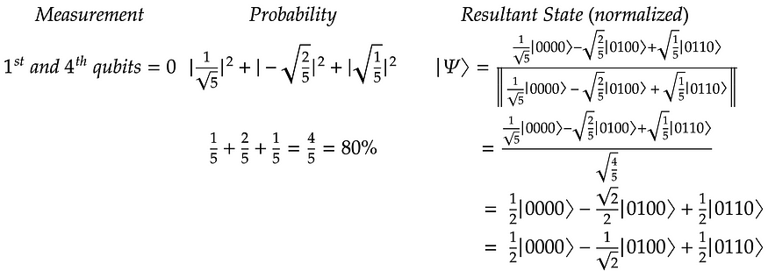
Pengukuran Qubit Ganda
Misalkan kita memiliki dua Qubit dengan status berikut :
Pengukuran Kuantum Qubit Parsial
Pengukuran Qubit pertama dan Qubit keempat sehingga didapat Qubit pertama =0 dan Qubit keempat= 0. Untuk melakukannya kita hanya perlu memperhatikan |0000⟩, |0100⟩, dan |0110⟩ yang memiliki qubit pertama dan keempat = 0 (disorot di bawah).

Slide 12
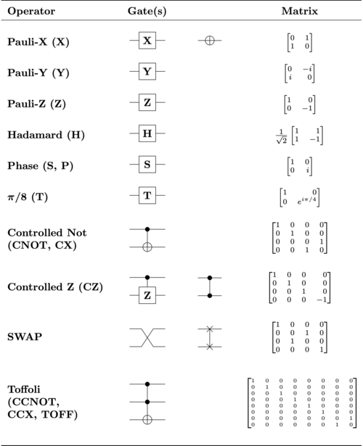
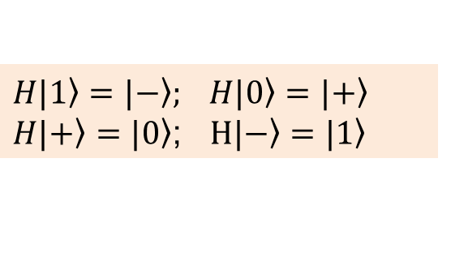
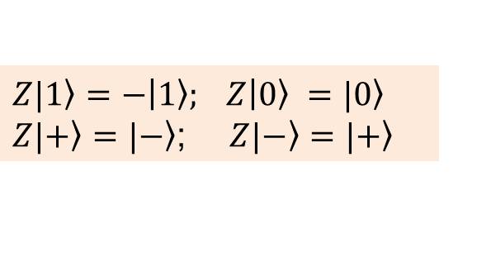
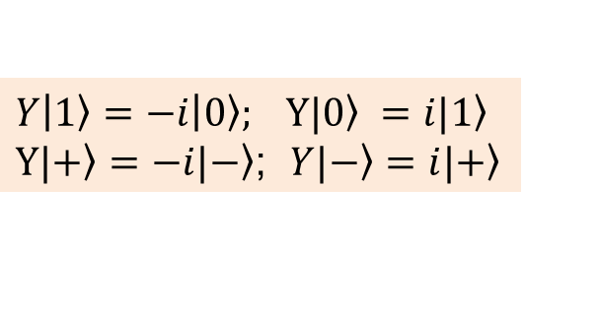
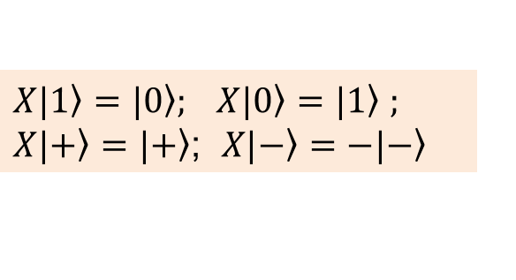
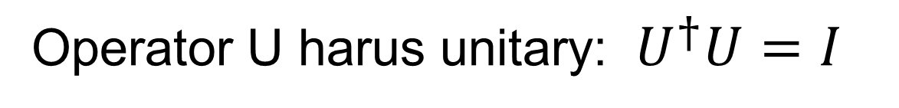
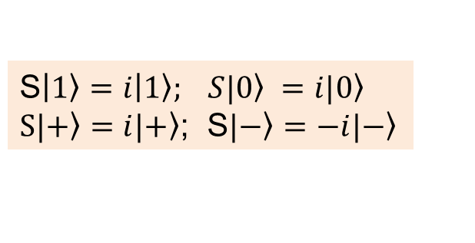
Operasi pada Qubit Tunggal
Single qubit operator U beroperasi pada satu qubit dan digunakan untuk memanipulasi qubit, misalnya membuat superposisi atau melakukan rotasi.
Operator U harus unitary: $U^{†}U=I$
Single-Qubit Gates Operator
$X|\left.1\right\rangle =|\left.0\right\rangle ; X|\left.0\right\rangle =|\left.1\right\rangle$ $;$
$X|\left.+\right\rangle =|\left.+\right\rangle$; $X|\left.−\right\rangle =−|\left.−\right\rangle$
$$Y\left|\left.1\right\rangle =−i\right|\left.0\right\rangle ; Y|\left.0\right\rangle =i|\left.1\right\rangle$$
$Y|\left.+\right\rangle =−i|\left.−\right\rangle$; $Y|\left.−\right\rangle =i|\left.+\right\rangle$
$$Z|\left.1\right\rangle =−\left|\left.1\right\rangle ; Z\right|\left.0\right\rangle =|\left.0\right\rangle$$
$Z|\left.+\right\rangle =|\left.−\right\rangle$; $Z|\left.−\right\rangle =|\left.+\right\rangle$
$$H|\left.1\right\rangle =|\left.−\right\rangle ; H|\left.0\right\rangle =|\left.+\right\rangle$$
$H|\left.+\right\rangle =|\left.0\right\rangle$; $H|\left.−\right\rangle =|\left.1\right\rangle$
S$\left|\left.1\right\rangle =i\right|\left.1\right\rangle ; S|\left.0\right\rangle =i|\left.0\right\rangle$
$S|\left.+\right\rangle =i|\left.+\right\rangle$; S$|\left.−\right\rangle =−i|\left.−\right\rangle$

Slide 13
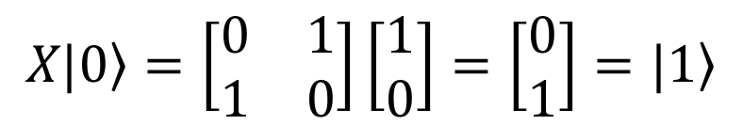
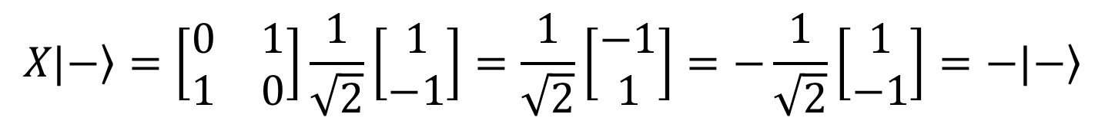
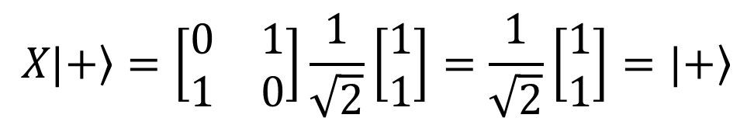
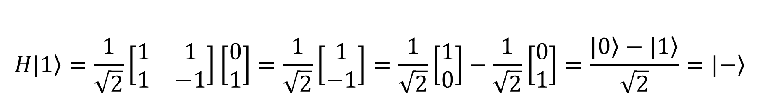
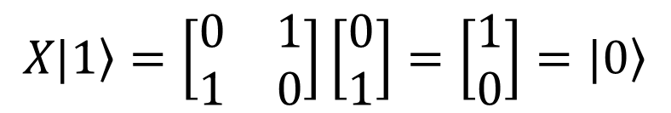
Operasi pada Qubit Tunggal
$$H|\left.0\right\rangle =\frac{1}{\sqrt{2}}\left[\begin{matrix}1 & 1 \\ 1 & −1\end{matrix}\right]\left[\begin{matrix}1 \\ 0\end{matrix}\right]=\frac{1}{\sqrt{2}}\left[\begin{matrix}1 \\ 1\end{matrix}\right]=\frac{1}{\sqrt{2}}\left[\begin{matrix}1 \\ 0\end{matrix}\right]+\frac{1}{\sqrt{2}}\left[\begin{matrix}0 \\ 1\end{matrix}\right]=\frac{|\left.0\right\rangle +|\left.1\right\rangle }{\sqrt{2}}=|\left.+\right\rangle$$
$$H|\left.1\right\rangle =\frac{1}{\sqrt{2}}\left[\begin{matrix}1 & 1 \\ 1 & −1\end{matrix}\right]\left[\begin{matrix}0 \\ 1\end{matrix}\right]=\frac{1}{\sqrt{2}}\left[\begin{matrix}1 \\ −1\end{matrix}\right]=\frac{1}{\sqrt{2}}\left[\begin{matrix}1 \\ 0\end{matrix}\right]−\frac{1}{\sqrt{2}}\left[\begin{matrix}0 \\ 1\end{matrix}\right]=\frac{|\left.0\right\rangle −|\left.1\right\rangle }{\sqrt{2}}=|\left.−\right\rangle$$
$$H|\left.−\right\rangle =H\left(\frac{|\left.0\right\rangle −|\left.1\right\rangle }{\sqrt{2}}\right)=\frac{1}{\sqrt{2}}\left(H\left|\left.0\right\rangle −H\right|\left.1\right\rangle \right)=\frac{1}{\sqrt{2}}\left(\frac{|\left.0\right\rangle +|\left.1\right\rangle }{\sqrt{2}}−\frac{|\left.0\right\rangle −|\left.1\right\rangle }{\sqrt{2}}\right)=|\left.1\right\rangle$$
$$H|\left.+\right\rangle =H\left(\frac{|\left.0\right\rangle +|\left.1\right\rangle }{\sqrt{2}}\right)=\frac{1}{\sqrt{2}}\left(H\left|\left.0\right\rangle +H\right|\left.1\right\rangle \right)=\frac{1}{\sqrt{2}}\left(\frac{|\left.0\right\rangle +|\left.1\right\rangle }{\sqrt{2}}+\frac{|\left.0\right\rangle −|\left.1\right\rangle }{\sqrt{2}}\right)=|\left.0\right\rangle$$
$$X|\left.0\right\rangle =\left[\begin{matrix}0 & 1 \\ 1 & 0\end{matrix}\right]\left[\begin{matrix}1 \\ 0\end{matrix}\right]=\left[\begin{matrix}0 \\ 1\end{matrix}\right]=|\left.1\right\rangle$$
$$X|\left.+\right\rangle =\left[\begin{matrix}0 & 1 \\ 1 & 0\end{matrix}\right]\frac{1}{\sqrt{2}}\left[\begin{matrix}1 \\ 1\end{matrix}\right]=\frac{1}{\sqrt{2}}\left[\begin{matrix}1 \\ 1\end{matrix}\right]=|\left.+\right\rangle$$
$$X|\left.1\right\rangle =\left[\begin{matrix}0 & 1 \\ 1 & 0\end{matrix}\right]\left[\begin{matrix}0 \\ 1\end{matrix}\right]=\left[\begin{matrix}1 \\ 0\end{matrix}\right]=|\left.0\right\rangle$$
$$X|\left.−\right\rangle =\left[\begin{matrix}0 & 1 \\ 1 & 0\end{matrix}\right]\frac{1}{\sqrt{2}}\left[\begin{matrix}1 \\ −1\end{matrix}\right]=\frac{1}{\sqrt{2}}\left[\begin{matrix}−1 \\ 1\end{matrix}\right]=−\frac{1}{\sqrt{2}}\left[\begin{matrix}1 \\ −1\end{matrix}\right]=−|\left.−\right\rangle$$

Slide 14
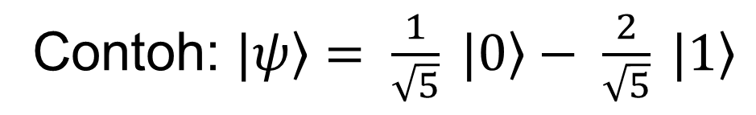
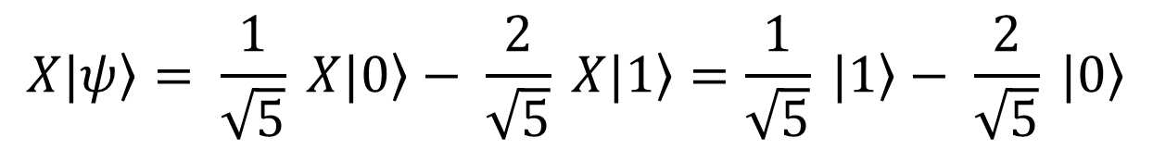
Operasi pada Qubit Tunggal
Contoh: $\left.|ψ\right\rangle = \frac{1}{\sqrt{5}} \left.|0\right\rangle − \frac{2}{\sqrt{5}} \left.|1\right\rangle$
$$\left.X|ψ\right\rangle = \frac{1}{\sqrt{5}} \left.X|0\right\rangle − \frac{2}{\sqrt{5}} \left.X|1\right\rangle =\frac{1}{\sqrt{5}} \left.|1\right\rangle − \frac{2}{\sqrt{5}} \left.|0\right\rangle$$
$$\left.XZ|ψ\right\rangle = \frac{1}{\sqrt{5}} \left.XZ|0\right\rangle − \frac{2}{\sqrt{5}} \left.XZ|1\right\rangle =\frac{1}{\sqrt{5}} \left.X|0\right\rangle +\frac{2}{\sqrt{5}} \left.X|1\right\rangle =\frac{1}{\sqrt{5}} \left.|1\right\rangle +\frac{2}{\sqrt{5}} \left.|0\right\rangle$$
$$\left.H|ψ\right\rangle = \frac{1}{\sqrt{5}} \left.H|0\right\rangle − \frac{2}{\sqrt{5}} \left.H|1\right\rangle =\frac{1}{\sqrt{5}} \frac{\left(\left.|1\right\rangle +\left.|0\right\rangle \right)}{\sqrt{2}}− \frac{2}{\sqrt{5}}\frac{\left(\left.|1\right\rangle −\left.|0\right\rangle \right)}{\sqrt{2}}=\frac{3}{\sqrt{10}}\left.|0\right\rangle −\frac{1}{\sqrt{10}}\left.|1\right\rangle$$

Slide 15
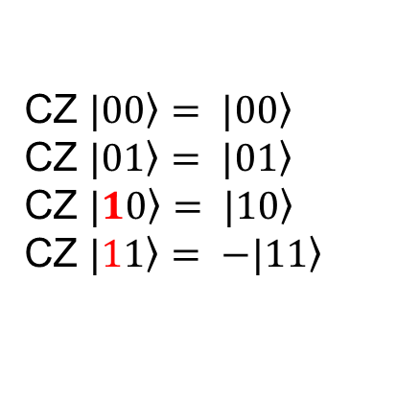
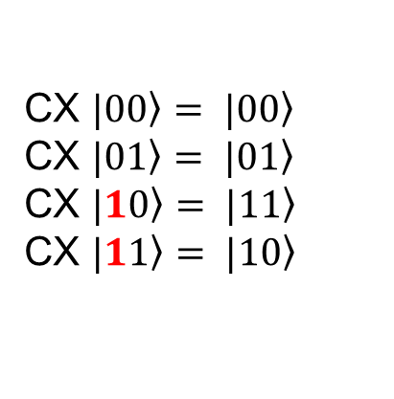
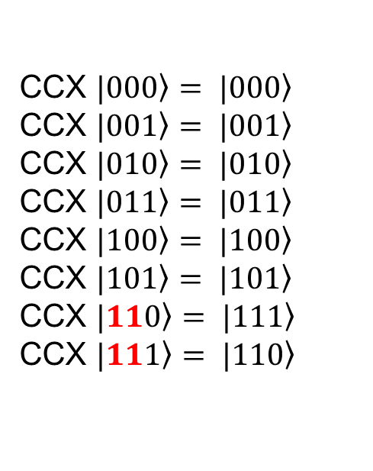
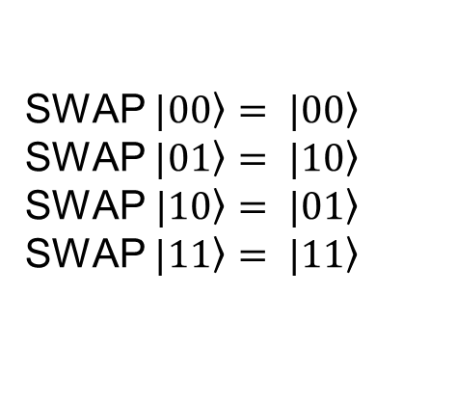
Operasi pada Qubit Ganda
CX $\left.|00\right\rangle = \left.|00\right\rangle$
CX $\left.|01\right\rangle = \left.|01\right\rangle$
CX $\left.|10\right\rangle = \left.|11\right\rangle$
CX $\left.|11\right\rangle = \left.|10\right\rangle$
CZ $\left.|00\right\rangle = \left.|00\right\rangle$
CZ $\left.|01\right\rangle = \left.|01\right\rangle$
CZ $\left.|10\right\rangle = \left.|10\right\rangle$
CZ $\left.|11\right\rangle = \left.−|11\right\rangle$
SWAP $\left.|00\right\rangle = \left.|00\right\rangle$
SWAP $\left.|01\right\rangle = \left.|10\right\rangle$
SWAP$\left.|10\right\rangle = \left.|01\right\rangle$
SWAP $\left.|11\right\rangle = \left.|11\right\rangle$
CCX $\left.|000\right\rangle = \left.|000\right\rangle$
CCX $\left.|001\right\rangle = \left.|001\right\rangle$
CCX $\left.|010\right\rangle = \left.|010\right\rangle$
CCX $\left.|011\right\rangle = \left.|011\right\rangle$
CCX $\left.|100\right\rangle = \left.|100\right\rangle$
CCX $\left.|101\right\rangle = \left.|101\right\rangle$
CCX $\left.|110\right\rangle = \left.|111\right\rangle$
CCX $\left.|111\right\rangle = \left.|110\right\rangle$

Slide 16
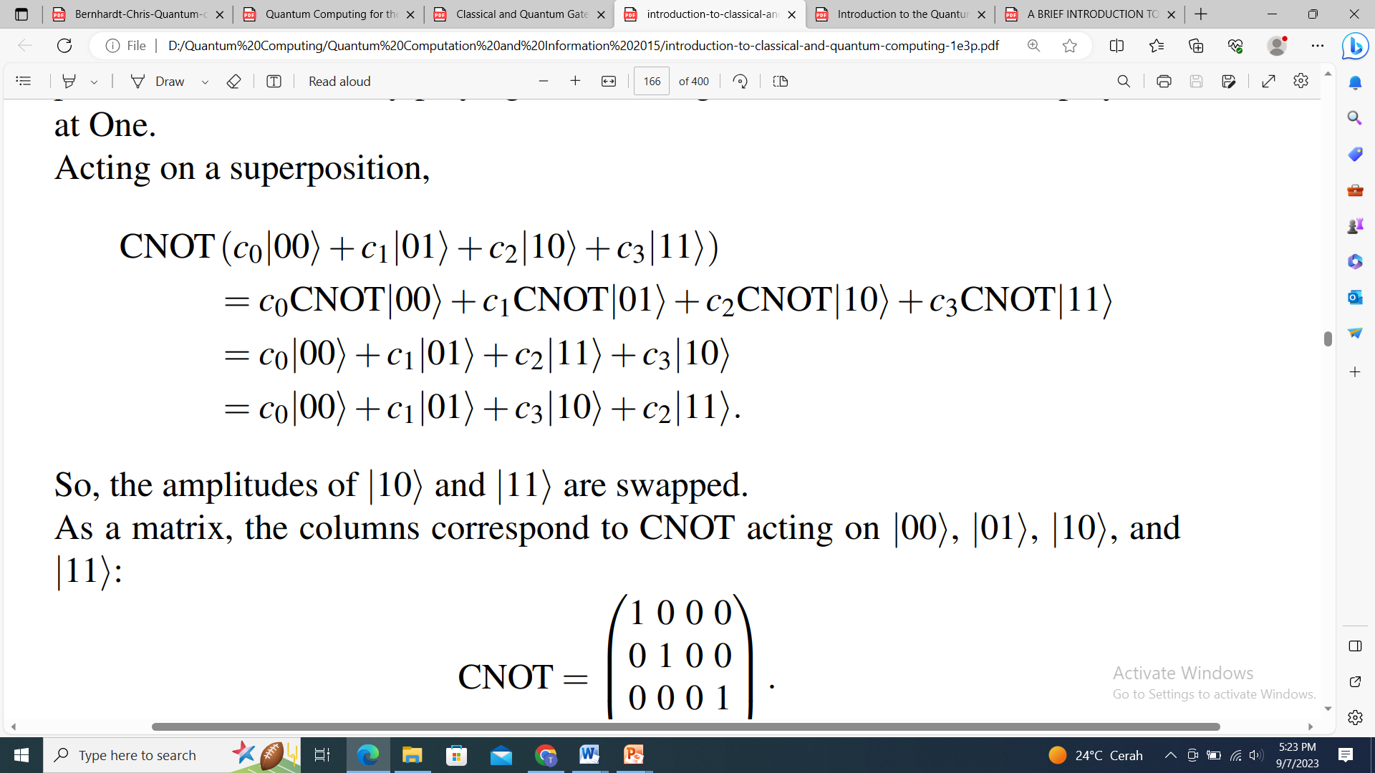
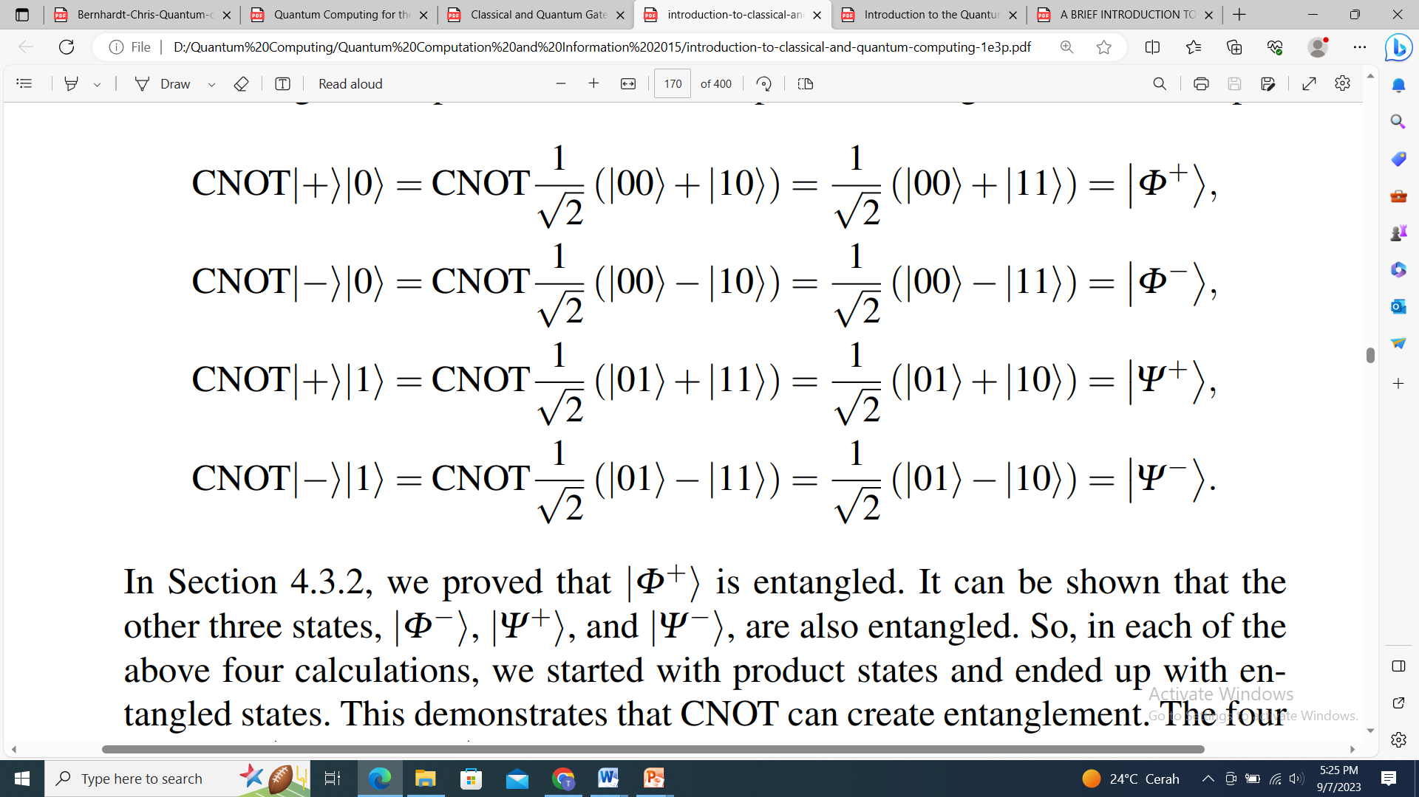
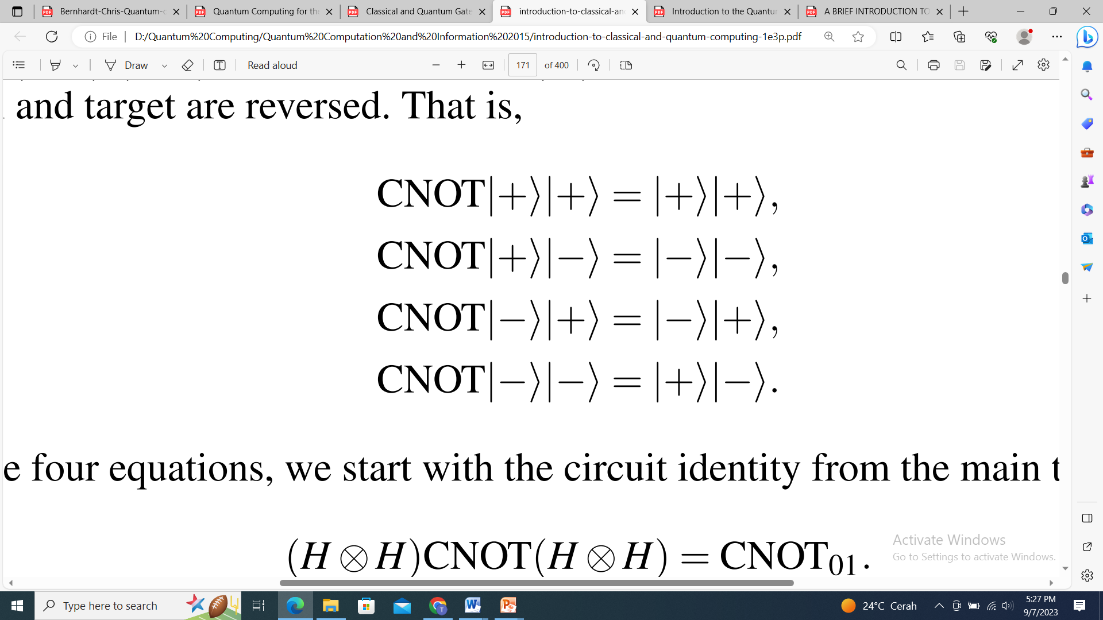
Operasi pada Qubit Ganda
The CNOT gate or controlled-NOT gate

Slide 17
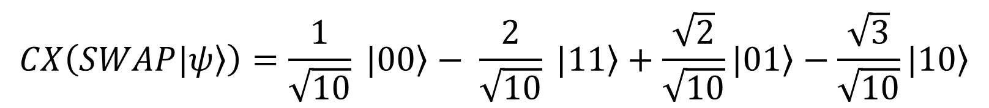




Operasi pada Qubit Ganda
$$\left.|ψ\right\rangle = \frac{1}{\sqrt{10}} \left.|00\right\rangle − \frac{2}{\sqrt{10}} \left.|01\right\rangle +\frac{\sqrt{2}}{\sqrt{10}}\left.|10\right\rangle −\frac{\sqrt{3}}{\sqrt{10}}\left.|11\right\rangle$$
$$CX\left(SWAP\left.|ψ\right\rangle \right)=CX\left(\frac{1}{\sqrt{10}} \left.|00\right\rangle − \frac{2}{\sqrt{10}} \left.|10\right\rangle +\frac{\sqrt{2}}{\sqrt{10}}\left.|01\right\rangle −\frac{\sqrt{3}}{\sqrt{10}}\left.|11\right\rangle \right)$$
$$CX\left(SWAP\left.|ψ\right\rangle \right)=\frac{1}{\sqrt{10}} \left.|00\right\rangle − \frac{2}{\sqrt{10}} \left.|11\right\rangle +\frac{\sqrt{2}}{\sqrt{10}}\left.|01\right\rangle −\frac{\sqrt{3}}{\sqrt{10}}\left.|10\right\rangle$$
$$\left.|ψ\right\rangle = \frac{1}{\sqrt{10}} \left.|001\right\rangle − \frac{2}{\sqrt{10}} \left.|111\right\rangle +\frac{\sqrt{2}}{\sqrt{10}}\left.|110\right\rangle −\frac{\sqrt{3}}{\sqrt{10}}\left.|101\right\rangle$$
$$\left.CCNOT(|ψ\right\rangle )= \frac{1}{\sqrt{10}} \left.|001\right\rangle − \frac{2}{\sqrt{10}} \left.|110\right\rangle +\frac{\sqrt{2}}{\sqrt{10}}\left.|111\right\rangle −\frac{\sqrt{3}}{\sqrt{10}}\left.|101\right\rangle$$

Slide 18






TERIMA KASIH

